Slide 1
NTRES 6940 Special Topics Fundamentals of R
Fall 2019
Ben Augustine
Jennifer Brazeal

Slide 2
Class Logistics
WHO
Jennifer Brazeal, jb2634@cornell.edu
Ben Augustine, ba378@cornell.edu
WHAT
1 week “workshop” style class to introduce you to R
WHEN
T/W/Th/F/M
9/3/19 – 9/9/19
4:35 – 7:00 pm
WHERE
Warren Hall 150

Slide 3
Introductions
Name
Department
Year
Reason for interest in R, what do you hope to get out of this class
R competency

Slide 4
Course Objectives
Build an introductory foundation that will help get you jumpstarted in using R for future classes and/or your own research.
Basic applications of R: data manipulation, common plotting and statistical analyses
How to get help with R errors and learn on your own
Best practices, conventions, and tips

Slide 5
Course Outline
Day 1: Reading in data, running scripts, basic data manipulation
Day 2: Logic, loops
Day 3: Data Visualization
Day 4: Basic probability and statistics in R
Day 5: Introduction to some commonly used R packages for data visualization and reproducible research, questions (general, own data, etc.)
Throughout: Interpreting errors, how to solve code bugs

Slide 6
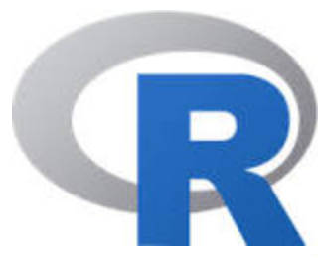
What is it?
All purpose software, built by statisticians:
Why not just Excel? R better for:
Really large data sets
Reproducible workflow
Data visualization
Different data types
More complex math and calculations
Coding in R will help you develop skills that you can use in other programs
It’s free!
Notes:
Excel has a lot of bloat: font, color, formatting, etc.

Slide 7
How it works
Math, stats, and data visualization
Built in functions to perform/calculate common things, e.g.
sum(), mean(), min(), max(), sd(),
You can also create your own custom functions
R Packages are built by people around a functional theme. Makes it easy for the average user to utilize R for specific purposes.
Create plots, figures, tables, maps, etc. for your research.
Store the code that created and analyzed your data, as well as the data itself, for future use; reproducible research!

Slide 8
Lets download R
https://www.r-project.org/
If you use it regularly, or once you start using it more, make sure you keep current with the newest version
And while we’re at it, R Studio.
https://www.rstudio.com/
Why? Has useful components for organization

Slide 9
Reference card
https://cran.r-project.org/doc/contrib/Short-refcard.pdf

